Slide 1
CPE 133
Setup & Hold Times
Maximum FSM Clock Frequencies
Example

Slide 2
Clocking Terms
Period (units = time)
Frequency (units = 1/time = Hz)

Slide 3
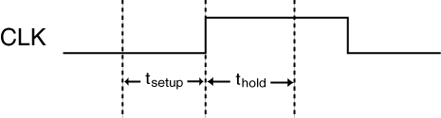
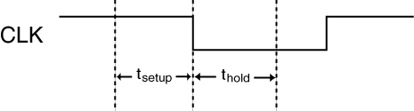
Clocking Issues
Issue with Edge-sensitive devices
Setup Time: the amount of time a circuit’s inputs must be stable before the clock edge
Hold Time: the amount of time a circuit’s inputs must be stable after the clock edge
Rising Edge
Falling Edge

Slide 4
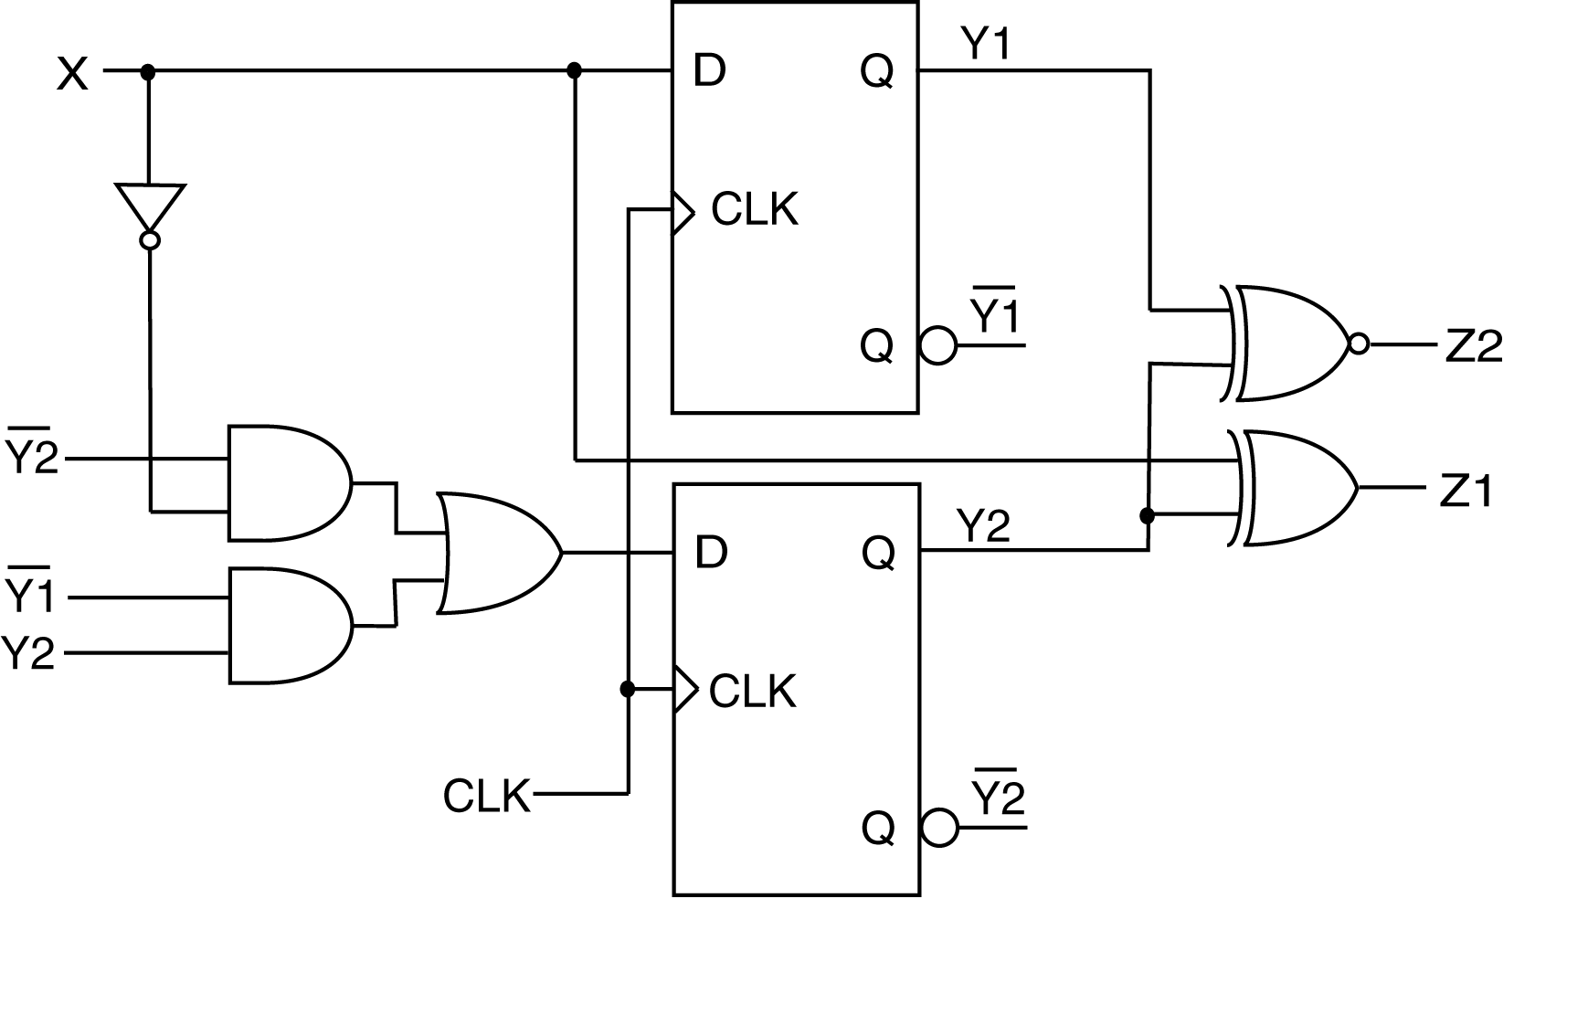
Old Approach & New Approach
Old Approach
New Approach

Slide 5
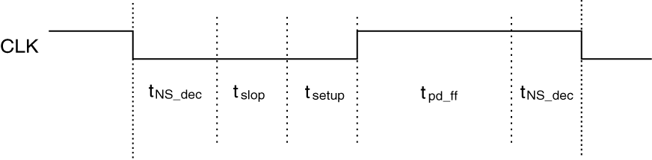
FSM Max Clock Frequencies
Max Clock = min period
Four important times
Setup time
FF prop delay time (assumed > than hold time)
NS Decoder prop delay time
Safety margin time

Slide 6
FSM Max Clock Frequencies

Slide 7
Example: What is the maximum system clock frequency at which the following sequential circuit can operate? For this problem, the flip-flops have a setup time of 10ns and a propagation delay of 17ns. The next-state decoder has a propagation of 13ns For this problem, add a safety margin of 12ns. Assume the propagation delay for the flip-flops is greater than the hold time. Assume the X input is stable and the Z1 and Z2 outputs drive a circuit that is not sensitive to the maximum clock frequency.

Slide 8
Example Problem
Design a circuit with the following attributes. The circuit has an 8-bit input and 8-bit output (both unsigned binary). When the circuit receives a GO signal, the circuit averages 8 values from the input (one per clock cycle) and continuously outputs the result until another it receives another GO signal. The circuit only includes values greater than 0x47 in the average.
Minimize the use of hardware in your design
Provide a state diagram if necessary
State how your circuit is controlled

